Slide 1
Chapter 8 - Selecting a Study Design

Slide 2
Topics covered
Differences between quantitative and qualitative study designs
Common study designs in quantitative research
Common study designs in qualitative research
Other philosophy-guided designs

Slide 3
Differences between quantitative and qualitative study designs
Quantitative studies designs:
Specific
Rigid
Well structured
Ensure validity and reliability
Qualitative research designs:
Flexible
Emergent
Non-sequential
Differences in philosophical perspectives determine the approach of enquiry

Slide 4
Study designs in quantitative research
Study designs can be classified by examining from three different perspectives:
The number of contacts with the study population
The reference period of the study
The nature of the investigation

Slide 5
Study designs based on the number of contacts
Cross-sectional: most common and take a cross-section of the population at one point in time
Before-and-after: also known as pre-test/post-test design which take two cross-sectional data collection points on the same population to find out changes.
Longitudinal: the population is researched a number of times; a series of repetitive cross-sectional studies collecting the same information

Slide 6
Study designs based on the reference period (time-frame)
Retrospective: investigate things that happened in the past
Prospective: investigate things that are likely to happen in the future, such as experiments
Retrospective-prospective: focus on both past trends and study it into the future, such as before-and-after studies without a control group

Slide 7
Study designs based on the nature of the investigation
Experimental: starting from the cause to establish the effect; the researcher introduces the intervention that is assumed to cause the change in a controlled or natural environment.

Slide 8
Experimental designs
Random design
The after-only design
The before-and-after experimental design
The control group design
The double control group design
The comparative design
The ‘matched control’ experimental design
The placebo design

Slide 9
Study designs based on the nature of the investigation - continued
Non-experimental: Starting with the effect to research the cause; a phenomenon is known and the researcher attempts to establish what caused it.
Quasi- or semi-experimental: This design has elements of both experimental and non-experimental studies.

Slide 10
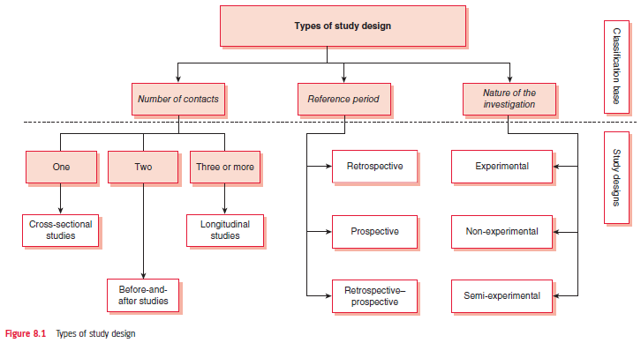
Figure 8.1 Types of study design

Slide 11
Other quantitative designs
Online surveys
The cross-over comparative experimental design
The replicated cross-sectional design
Trend studies
Cohort studies
Panel studies
Blind studies
Double-blind studies

Slide 12
Study designs in qualitative research
Case studies: In-depth exploration of a atypical case of a particular event, group, instance, etc.
Oral history: Obtaining, recording, presenting and interpreting information in someone’s own words
Focus groups/ group interviews: Facilitated group interviews of an open discussion of a topic

Slide 13
Study designs in qualitative research continued
Participant observation: Researcher gets involved in a social interaction and observes the situation first hand
Holistic research: More a philosophy, research from every perspective
Community discussion forums: Large group discussion
Reflective journal log: Diary of the researcher’s thoughts

Slide 14
Other philosophy-guided designs
Action Research: Research that requires action to improve practice or take action to an issue
Feminist research: Underpinned by feminist concerns in terms social inequality between men and women
Participatory and collaborative research enquiry: Based on the philosophy of community development involving community members actively in the research process

